Slide 1
Machine Learning
Basics

Slide 2
Keep in mind: ML is like an exam
It’s the performance on the D-day which matters
In an exam, our success is measured based on how well we did on the questions in the test (not on the questions we practiced on)
Likewise, in ML, success of the learned model is measured based on how well it predicts/fits the future test data (not the training data)
In Machine Learning, generalization performance
on the test data matters

Slide 3

A Loose Taxonomy of ML
“Labeled” means, during training, for each input, the corresponding output is available (i.e., the machine learner is explicitly told that a cat image is of a cat)
Learning using labeled data
Learning using unlabeled data
Some examples of
supervised learning problems
Classification
Regression
Supervised
Learning
Unsupervised
Learning
Some examples of
unsupervised learning problems
Clustering
Dimensionality Reduction
Machine Learning
Many other specialized flavors of ML also exist,
some of which include
Semi-supervised Learning
Active Learning
Transfer Learning
Multitask Learning
Imitation Learning (somewhat related to RL)
Zero-Shot Learning
Few-Shot Learning
Continual learning
RL doesn’t use “labeled” or
“unlabeled” data in the traditional sense! In RL, an agent learns via
its interactions with an environment
Reinforcement Learning

Slide 4








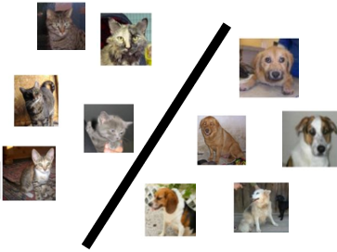
A Typical Supervised Learning Workflow
Note: This example is for the problem of binary classification, a supervised learning problem
Labeled
Training
Data
“dog”
“dog”
“dog”
“dog”
“dog”
Is feature extraction done “manually” as a pre-processing step before the ML algo starts working? Can’t we “automate” this part? Can’t we “learn” good features directly from raw inputs?
“cat”
“dog”
“cat”
“Feature”
Extraction
“cat”
ML Algorithm
(outputs a “model”)
“cat”
“cat”
“cat”
Feature extraction converts raw inputs to a numeric representation that the ML algo can understand and work with. More on feature extraction later.
Predicted Label
(cat/dog)
Test
Image
“Feature”
Extraction
Cat vs Dog
Prediction model
Indeed. Deep Learning algos do precisely that!
(feature + model learning). More on Deep Learning later.
https://www.pinclipart.com/, http://www.pngtree.com

Slide 5
A Typical Unsupervised Learning Workflow
Note: This example is for the problem of data clustering, an unsupervised learning problem
Unlabeled
Data
Yes. In this example, given a new “test” cat/dog image, we can assign it to the cluster with closer centroid
“Feature”
Extraction
ML Algorithm
(outputs a clustering)
Does unsupervised learning also have a test phase? That is, can we also predict the cluster of a new test input?
https://www.pinclipart.com/, http://www.pngtree.com

Slide 6


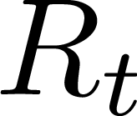
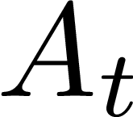


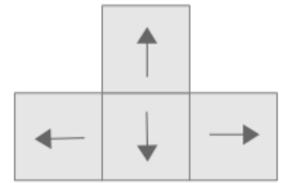


A Typical Reinforcement Learning Workflow
Wish to teach an agent optimal policy for some task
Agent does the following repeatedly
Senses/observes the environment
Takes an action based on its current policy
Receives a reward for that action
Updates its policy
Agent’s goal is to maximize its overall reward
Agent State
Observation
Reward
Action
Environment State at time t

Slide 7
Data and Features

Slide 8
Data and Features
Features represent semantics of the inputs. Being able to extract good features is key to the success of ML algos
ML algos require a numeric feature representation of the inputs
Features can be obtained using one of the two approaches
Approach 1: Extracting/constructing features manually from raw inputs
Approach 2: Learning the features from raw inputs
Approach 1 is what we will focus on primarily for now
Approach 2 is what is followed in Deep Learning algorithms
Approach 1 is not as powerful as Approach 2 but still used widely

Slide 9
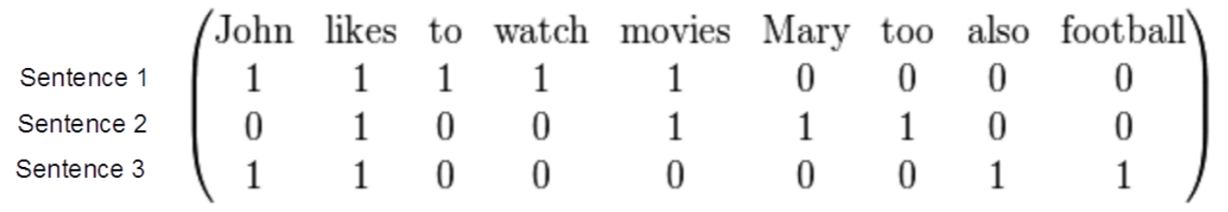
Example: Feature Extraction for Text Data
Consider some text data consisting of the following sentences:
John likes to watch movies
Mary likes movies too
John also likes football
Want to construct a feature representation for these sentences
Here is a “bag-of-words” (BoW) feature representation of these sentences
Each sentence is now represented as a binary vector (each feature is a binary value, denoting presence or absence of a word). BoW is also called “unigram” rep.
BoW is just one of the many ways of doing feature extraction for text data. Not the most optimal one, and has various flaws (can you think of some?), but often works reasonably well

Slide 10
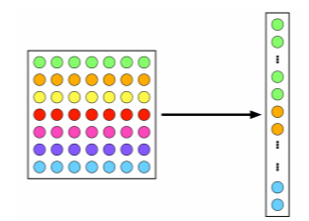
Example: Feature Extraction for Image Data
A very simple feature extraction approach for image data is flattening
Many other manual feature extraction techniques developed in computer vision and image processing communities (SIFT, HoG, and others)
Flattening and histogram based methods destroy the spatial information in the image but often still work reasonably well
7x7 image
(49 pixels)
Vector of pixel
intensities
Pic credit: cat.uab.cat/Research/object-recognition

Slide 11
Feature Selection
Not all the extracted features may be relevant for learning the model (some may even confuse the learner)
Feature selection (a step after feature extraction) can be used to identify the features that matter, and discard the others, for more effective learning
Many techniques exist – some based on intuition, some based on algorithmic principles
Age
Gender
Height
Weight
Eye color
Calculating BMI from this data doesn’t require ML but this simple example is just to illustrate the idea of feature selection ☺
Body-mass index (BMI)

Slide 12
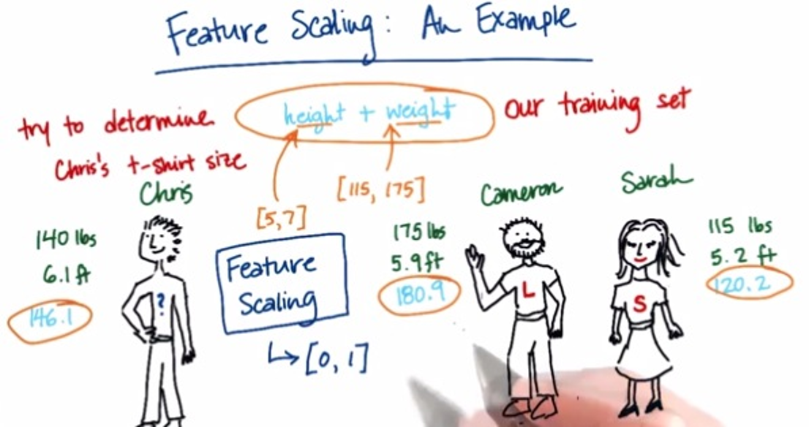
Some More Postprocessing: Feature Scaling
Even after feature selection, the features may not be on the same scale
This can be problematic when comparing two inputs – features that have larger scales may dominate the result of such comparisons
Therefore, helpful to standardize the features (e.g., by bringing all of them on the same scale such as between 0 to 1)
Pic credit: https://becominghuman.ai/demystifying-feature-scaling-baff53e9b3fd, https://stackoverflow.com/

Slide 13
Types of Features and Types of Outputs
Features as well as outputs can be real-valued, binary, categorical, ordinal, etc.
Real-valued: Pixel intensity, house area, house price, rainfall amount, temperature, etc
Binary: Male/female, adult/non-adult, or any yes/no or present/absent type value
Categorical/Discrete: Zipcode, blood-group, or any “one from a finite many choices“ value
Ordinal: Grade (A/B/C etc.) in a course, or any other type where relative values matter
Often, the features can be of mixed types (some real, some categorical, some ordinal, etc.)

Slide 14
Notations and Conventions

Slide 15
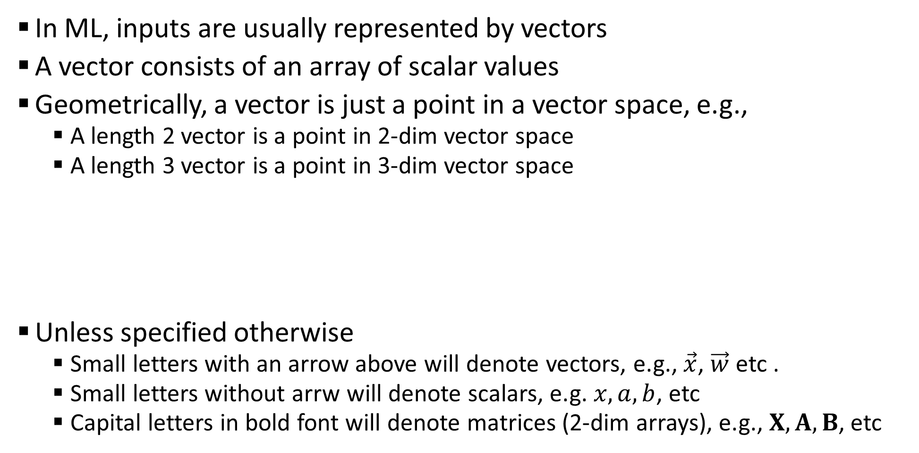
Some Notation and Conventions
In ML, inputs are usually represented by vectors
A vector consists of an array of scalar values
Geometrically, a vector is just a point in a vector space, e.g.,
A length 2 vector is a point in 2-dim vector space
A length 3 vector is a point in 3-dim vector space
Unless specified otherwise
Small letters with an arrow above will denote vectors, e.g., $\vec{x}$, $\vec{w}$ etc .
Small letters without arrw will denote scalars, e.g. $x, a, b$, etc
Capital letters in bold font will denote matrices (2-dim arrays), e.g., $X, A, B$, etc
0.5 | 0.3 | 0.6 | 0.1 | 0.2 | 0.5 | 0.9 | 0.2 | 0.1 | 0.5
Likewise for higher dimensions, even though harder to visualize
(0.5,0.3)
(0.5,0.3,0.6)
0.5 | 0.3 | 0.6
0.5 | 0.3

Slide 16
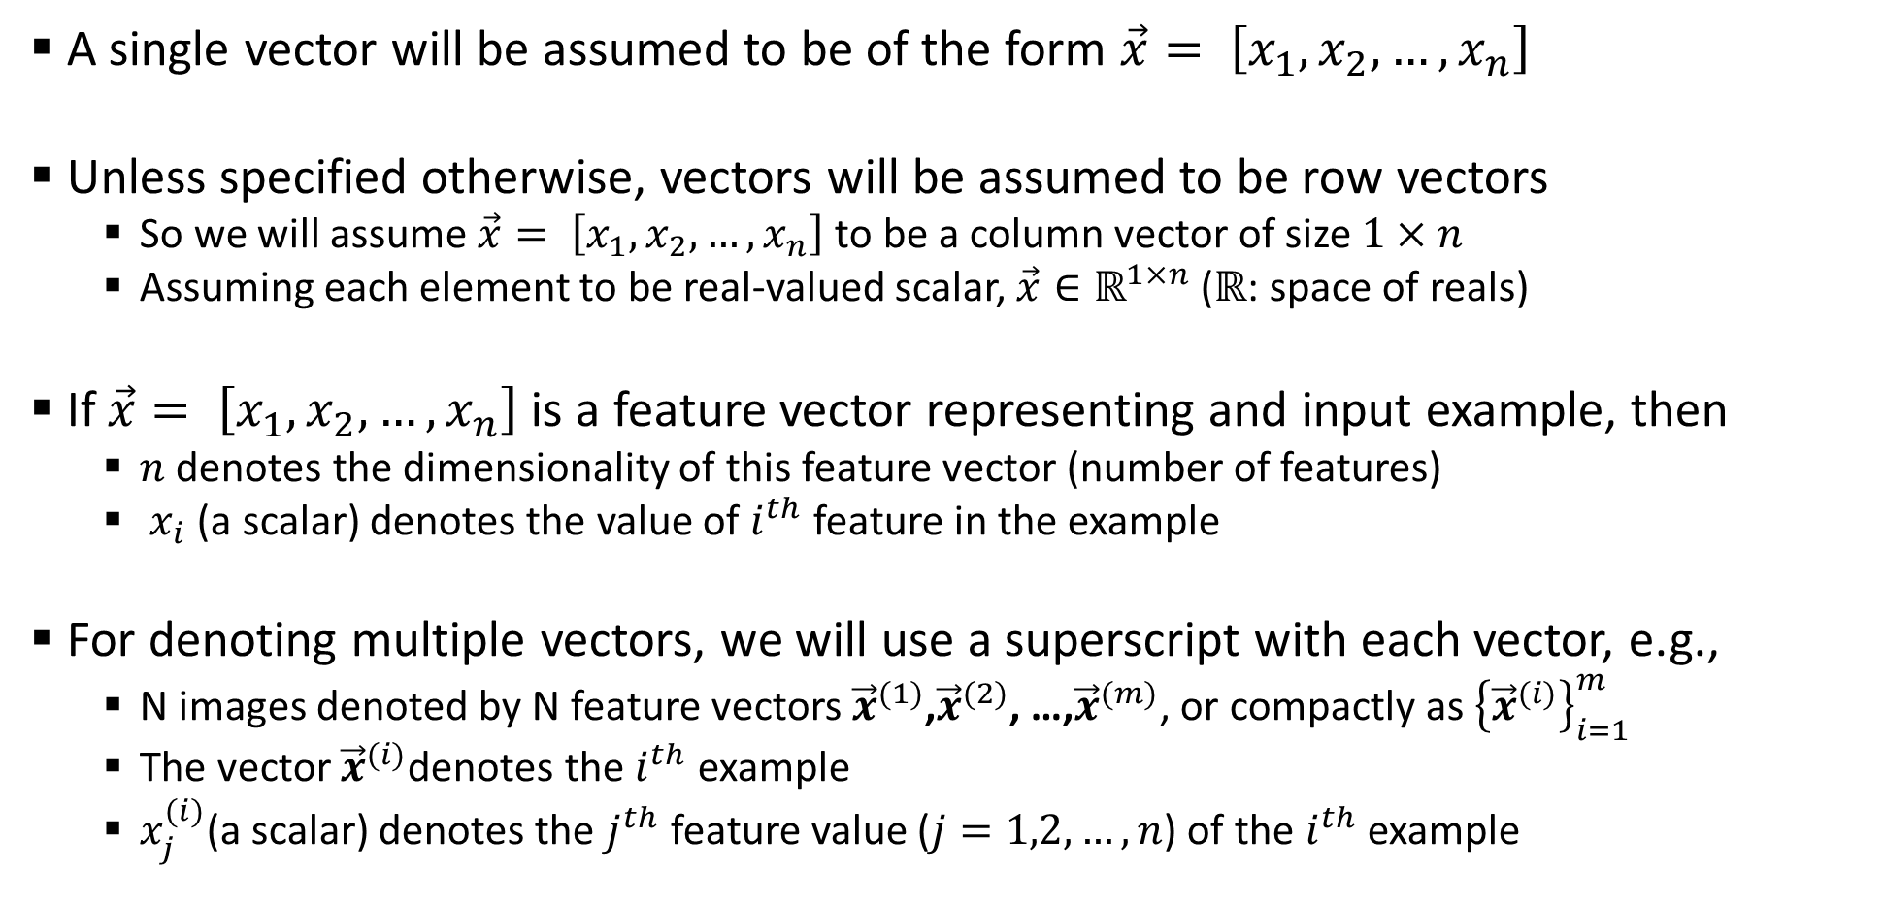
Some Notation and Conventions
A single vector will be assumed to be of the form $\vec{x}= \left[x_{1},x_{2},…,x_{n}\right]$
Unless specified otherwise, vectors will be assumed to be row vectors
So we will assume $\vec{x}= \left[x_{1},x_{2},…,x_{n}\right]$ to be a column vector of size $1×n$
Assuming each element to be real-valued scalar, $\vec{x}∈ℝ^{1×n}$ ($ℝ$: space of reals)
If $\vec{x}= \left[x_{1},x_{2},…,x_{n}\right]$ is a feature vector representing and input example, then
$n$ denotes the dimensionality of this feature vector (number of features)
$x_{i}$(a scalar) denotes the value of $i^{th}$feature in the example
For denoting multiple vectors, we will use a superscript with each vector, e.g.,
N images denoted by N feature vectors ${\vec{x}}^{(1)}$,${\vec{x}}^{(2)}$, …,${\vec{x}}^{(m)}$, or compactly as ${\left\{{\vec{x}}^{(i)}\right\}}_{i=1}^{m}$
The vector ${\vec{x}}^{(i)}$denotes the $i^{th}$ example
$x_{j}^{(i)}$(a scalar) denotes the $j^{th}$ feature value ($j=1,2,…,n$) of the $i^{th}$ example

Slide 17
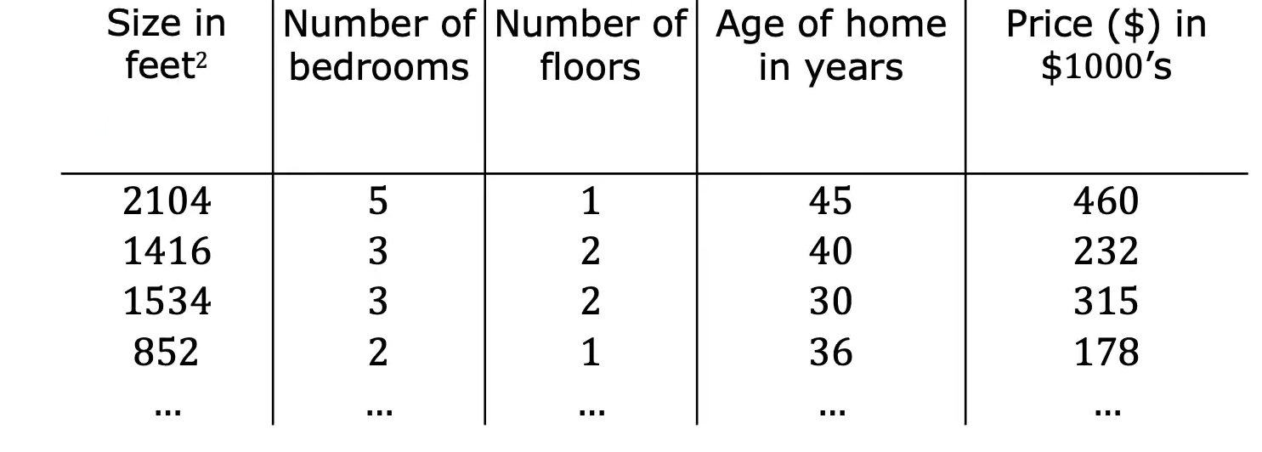
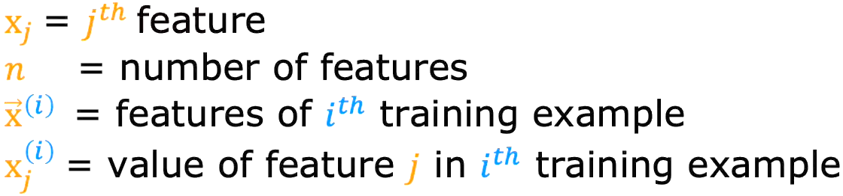


Some Notation and Conventions
x₁
x₂
x₃
x₄
y
$$x^{(2)}=[1416 3 2 40]$$
$$x_{3}^{(2)}= 2$$

Slide 18
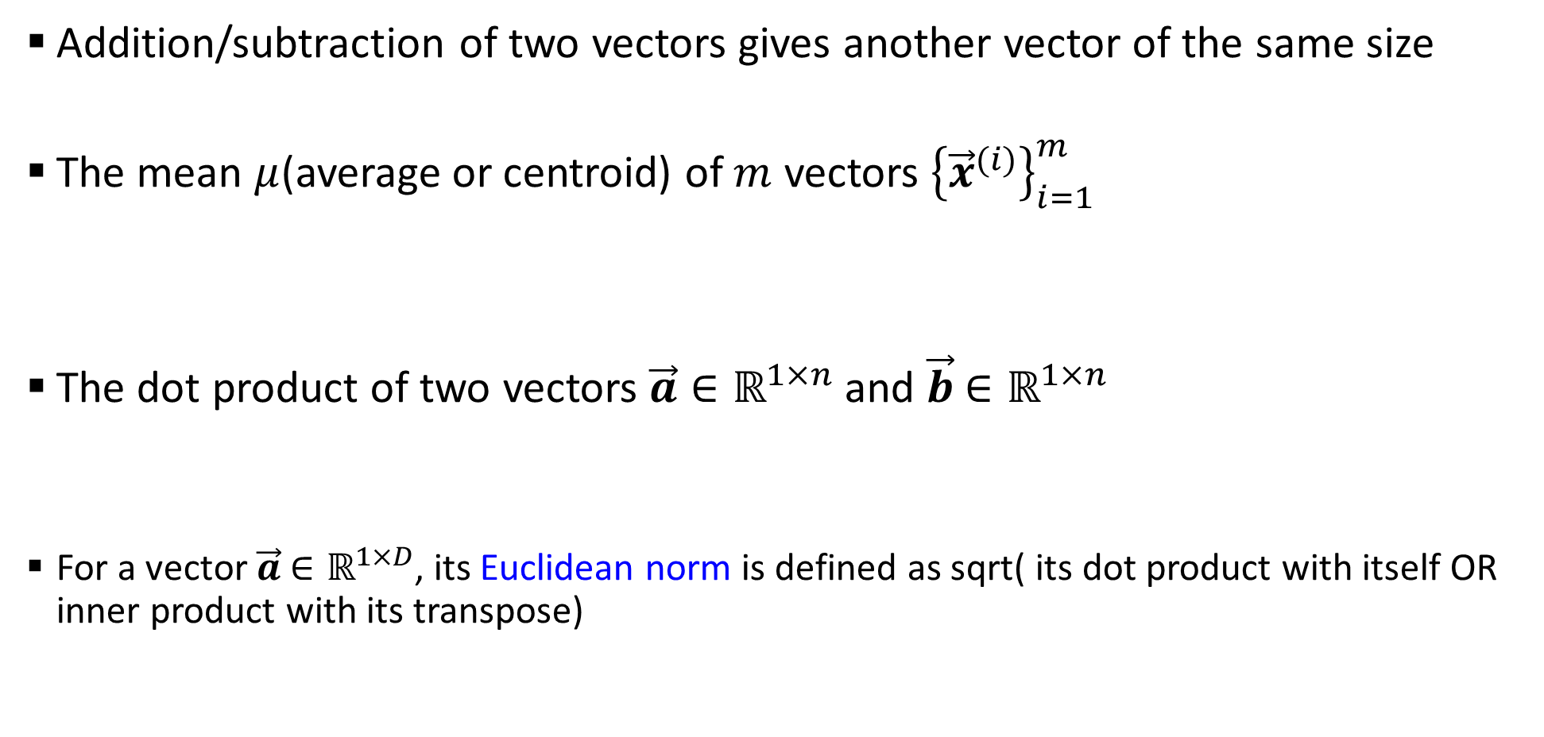
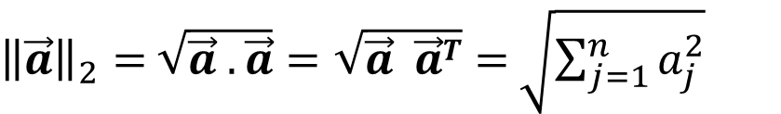
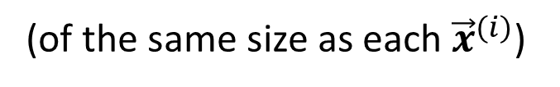


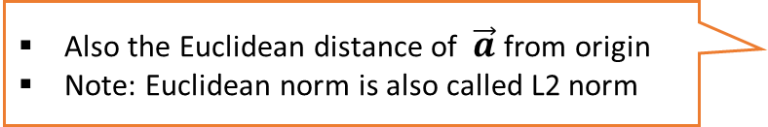
Some Basic Operations on Vectors
Addition/subtraction of two vectors gives another vector of the same size
The mean $μ$(average or centroid) of $m$ vectors ${\left\{{\vec{x}}^{(i)}\right\}}_{i=1}^{m}$
The dot product of two vectors $\vec{a}∈ℝ^{1×n}$and $\vec{b}$ $∈ℝ^{1×n}$
For a vector $\vec{a}$ $∈ℝ^{1×D}$, its Euclidean norm is defined as sqrt( its dot product with itself OR inner product with its transpose)
$$\vec{μ}= \frac{1}{m}\sum_{i=1}^{m}{{\vec{x}}^{(i)}}$$
(of the same size as each ${\vec{x}}^{(i)}$)
$$\vec{a} . \vec{b} =\sum_{j=1}^{n}{a_{j}b_{j}}$$
${\left\|\vec{a}\right\|}_{2}=$ $\sqrt{\vec{a} . \vec{a}}=\sqrt{\vec{a} \vec{a}T}=$ $\sqrt{\sum_{j=1}^{n}{a_{j}^{2}}}$
Also the Euclidean distance of $\vec{a}$from origin
Note: Euclidean norm is also called L2 norm

Slide 19

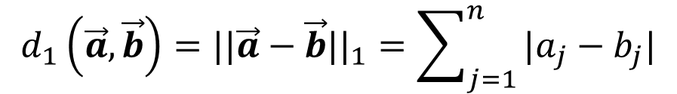

Computing Distances
Euclidean (L2 norm) distance between two vectors $\vec{a}∈ℝ^{1×n}$and $\vec{b}$ $∈ℝ^{1×n}$
Weighted Euclidean distance between two vectors $\vec{a}∈ℝ^{1×n}$and $\vec{b}$ $∈ℝ^{1×n}$
Absolute (L1 norm) distance between two vectors $\vec{a}∈ℝ^{1×n}$and $\vec{b}$ $∈ℝ^{1×n}$
$$d_{2}\left(\vec{a},\vec{b}\right)={||\vec{a}−\vec{b}||}_{2}=\sqrt{\sum_{j=1}^{n}{{\left(a_{j}−b_{j}\right)}^{2}}}=\sqrt{\left(\vec{a}−\vec{b}\right).\left(\vec{a}−\vec{b}\right)}=\sqrt{{\left(\vec{a}−\vec{b}\right)\left(\vec{a}−\vec{b}\right)}^{⊤}}$$
$$d_{\vec{w}}\left(\vec{a},\vec{b}\right)=\sqrt{\sum_{j=1}^{n}{{w_{j}\left(a_{j}−b_{j}\right)}^{2}}}$$
L1 norm distance is also known as the Manhattan distance or Taxicab norm
(it’s a very natural notion of distance between two points in some vector space)
Apart from L2 and L1. there other ways of defining distances?
$$d_{1}\left(\vec{a},\vec{b}\right)={||\vec{a}−\vec{b}||}_{1}=\sum_{j=1}^{n}{|a_{j}−b_{j}|}$$
Yes. Another, although less commonly used, distance is the L-infinity distance (equals to max of abs-value of element-wise difference between two vectors

